Slide 1
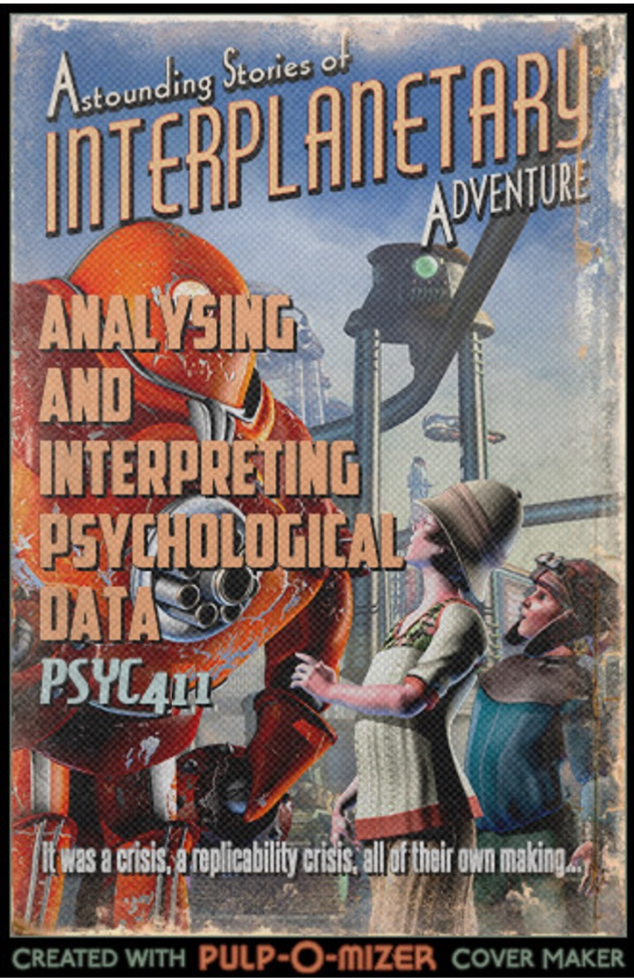
PSYC401: Analysing and Interpreting Psychological Data I
Padraic Monaghan
Room C5, Fylde College
p.monaghan@lancaster.ac.uk

Slide 2
Module outline
Week 1: Introducing data, introducing Rstudio
Week 2: Manipulating data, using Rstudio
Week 3: Exploring data and creating figures and graphs, using Rstudio
Week 4: Categorical data and the chi-squared test – testing random versus structured?
Week 5: t-tests – testing whether two groups are different
Week 6: Research report/analysis
Week 7: Measurement, hypotheses, associations (correlations)
Week 8: Predicting behaviour: the linear model
Week 9: Data visualisation
Week 10: Predicting behaviour: developing the linear model

Slide 3
Objectives for Week 4
By the end of this session, you should be able to:
Understand the value of conducting statistical tests and interpreting p-values
Understand null effects and null hypotheses
Understand the difference between parametric and non-parametric data
Understand when to apply the Chi-squared test
Understand the relation between Cramer’s V test and the Chi-squared test
Be able to apply the Chi-squared test to data and interpret the result
Be able to apply Cramer’s V test to data

